Slide 1
Gavilan Community College District
Educational Master Plan (EMP)
Overview Presentation
November 15, 2016
Cambridge West Partnership, LLC

Slide 2
Cambridge West Partnership
C.M. Brahmbhatt
Senior Partner and Manager
Joyce Black
Senior Partner and Project Leader
Fred Trapp
Senior Associate
Austin Dike
Associate
The Team

Slide 3
Our Experience
Participated in the development of over 20 Educational/Facilities Master Plans and 5 Educational Centers
Support for Accreditation and Educational Master Planning
Experienced in Bond Development and Planning
Preparation of 5YCP, Report 17, IPP’s & FPP’s
Excellent Reputation at the Chancellor’s Office
Have qualified over $600 million for State Funding
The Team

Slide 4
Community College Districts We Served
San Jose-Evergreen (San Jose City, Evergreen Valley)
City College of San Francisco
Kern (Porterville, Bakersfield, Cerro Coso)
Coast (Coastline, Golden West, Orange Coast)
Antelope Valley
Victor Valley
Barstow
Palo Verde
Long Beach
Mt. San Antonio
Cerritos
North Orange County (Fullerton, Cypress, School of Continuing Education)
Rancho Santiago (Santa Ana, Santiago Canyon, Noncredit Centers)
Palomar
Southwestern
The Clients

Slide 5
Guiding Principles
All campus planning begins with the program of instruction.
Planning must be built with and be supported by the college community.
All plans must be integrated into a unified whole supporting the college’s strategic plan.
Public policy and labor market data present opportunities.
approach

Slide 6
College Steering Committee
Dr. Peter Wruck, Co-chair
Dr. Randy Brown, Co-chair
Carina Cisneros, Administrator
Noemi Naranjo, Professional Support Staff
Linda Bernabe, Supervisor/Confidential
Scott Sandler, Faculty
Marisol Arredondo, Student

Slide 7
Project Web Page
Intranet
https://mail1.gavilan.edu/emp/

Slide 8
Importance of the Educational Master Plan
Required
Title 5, section 51008- Academic Master Plan
Expected
ACCJC accreditation activities now “look for” an EMP as part of integrated planning.
Role of the EMP
Frames a discussion to guide the future of the educational programs and student services.
Supports planning for future capital construction and the Facilities Master Plan.

Slide 9
Project Scope
The Gavilan College Educational Master Plan is…
the foundation for planning to meet the instructional and support service needs of Gavilan College
the basis for Gavilan College’s capital, facilities, technology, personnel and budget plans.
part of an integrated planning model and dynamic in nature intended to be reviewed periodically as new educational trends emerge and the needs of students and the district evolve.

Slide 10
Project Objectives
To create a vision for future educational program offerings.
To keep pace with and anticipate the changing needs of the students and communities served by the college.
To encourage consideration of alternative strategies for delivering instruction.
To provide guidance for creating a balanced curriculum.

Slide 11
Project Objectives
Foundation for other planning
To serve as a decision-making tool and reference for the future.
To link the college vision and mission to the planning process.

Slide 12
Core Questions
1. What might be the curriculum options for the College to match labor market needs, transfer opportunities, and community educational needs/interests?
2. How much additional or modified instructional and student services space might the College need in the future?
approach

Slide 13
Three Levels of Planning
Institutional (long range)
EMP, FMP, Strategic Plan
Functional (middle range)
See next slide
Unit (short range)
Program review, department/discipline, service area

Slide 14
EMP is Not…
The same as a functional-level plan
Technology
Student Success and Support Program
Student Equity
Distance Education
Deferred Maintenance
Enrollment Management
Outreach & Recruitment
Disaster Preparedness
Professional Development

Slide 15
EMP Overview
Message from President
Introduction
College History & Overview
Mission, Vision, Values
Environmental Scan
External
Internal
Institutional Effectiveness
Planning Assumptions, Strategic Priorities, & Goals
Opportunities for the Future
Projections for the Future Growth

Slide 16
EMP Process
Selection- Oct 2016
Fall 2016*
Data collection and analysis
Kick off meeting
Questionnaire and Interviews
Presentations to steering committee, Academic Senate, Student Government
Spring 2016*
Interviews
Presentations to steering committee
Open house
Board presentation (April)
*email and phone exchanges throughout

Slide 17
Data Collection Strategy
Define College Visions, Needs, Expectations
Questionnaire
Group Interviews
Deans and faculty
Directors and staff
Student Leadership
College Plans, Research Reports, and Data
See annotated required resources list
MIS Referential Files and Data Mart
Progress Reviews and Open Forums
Extensive Use of External Data, Studies, and Research
approach

Slide 18
EMP Approach
External Scan
Higher Education Public Policy
Economic Trends
Student Origins
Assessment of the College Effective Service Area
Data from the college
Access to MIS Referential Files (ST, SX, SG, XF, SP)
Fall 2010-2015
Annual Awards 2010-11 to 2015-16
approach

Slide 19
EMP Approach
approach
Internal Scan
Overall Headcount and Enrollment History
Student Characteristics
Analysis of the Program of Instruction
Non-instructional Resources to Support the Program of Instruction
Data from the college:
List of locally approved certificates
College goals and priorities
2005 to 2015 fall term only 1st census enrollment counts
2011-2015 fall term only WSCH and WSCH equivalent totals
Fall 2015 schedule file (excel spreadsheet and PDF)
Master room assignment list
Curriculum structure list (subject abbreviations related to divisions)
approach

Slide 20
EMP Approach
approach
Key Planning Assumptions, Strategic Priorities/Goals
Opportunities for the Future
Faculty and Student Services Future Visions (questionnaire and interviews)
Summarized highlights
Labor Market Data Analysis
Potential New Programs or Directions
Opportunities for Improvement and Expansion

Slide 21
EMP Approach
approach
Projections for the Future
Past History of Growth
Fall Terms
Weekly Student Contact Hours (WSCH)
Effective Service Area Demographics
College Age or Career Choice (18-24 years of age)
Young Adult or Career Starter (25-34 years of age)
Ethnicity
Educational Attainment, age 25 or older
Participation Rates

Slide 22
EMP Approach
approach
Baseline Term- Fall 2015
Section-level data
Segment by location
Account for online offerings
Consider combined classes
By discipline distinguish lecture from laboratory
Summarize WSCH by discipline
Projections for the Future
Future Capacity for Growth
WSCH growth as applied to the future program of instruction
For each division, department, discipline
Apply the growth rate to WSCH in the baseline
Calculate in five-year increments out to 2030

Slide 23
EMP Approach
Translating
For each division, department, discipline convert projected WSCH to
Estimated number of sections
Estimated Assignable Square Footage (ASF) and number of rooms
Apply State space use standards
Apply instructional management experience
approach

Slide 24
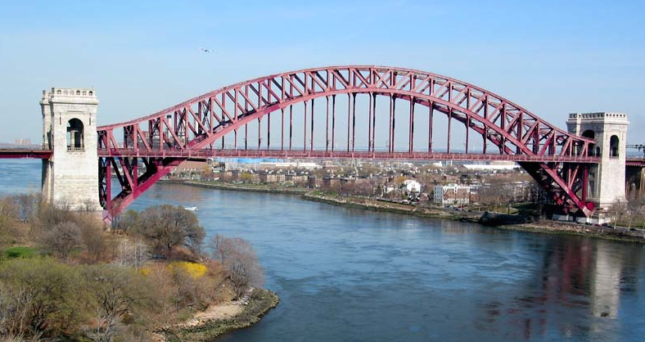
EMP Approach
Space Implications for Facilities Master Plan
Current instructional room assignments & ASF
Convert Weekly Student Contact Hours into Space
By discipline
Using State space standards
approach

Slide 25
Discussion
Questions and Answers

